Slide 1
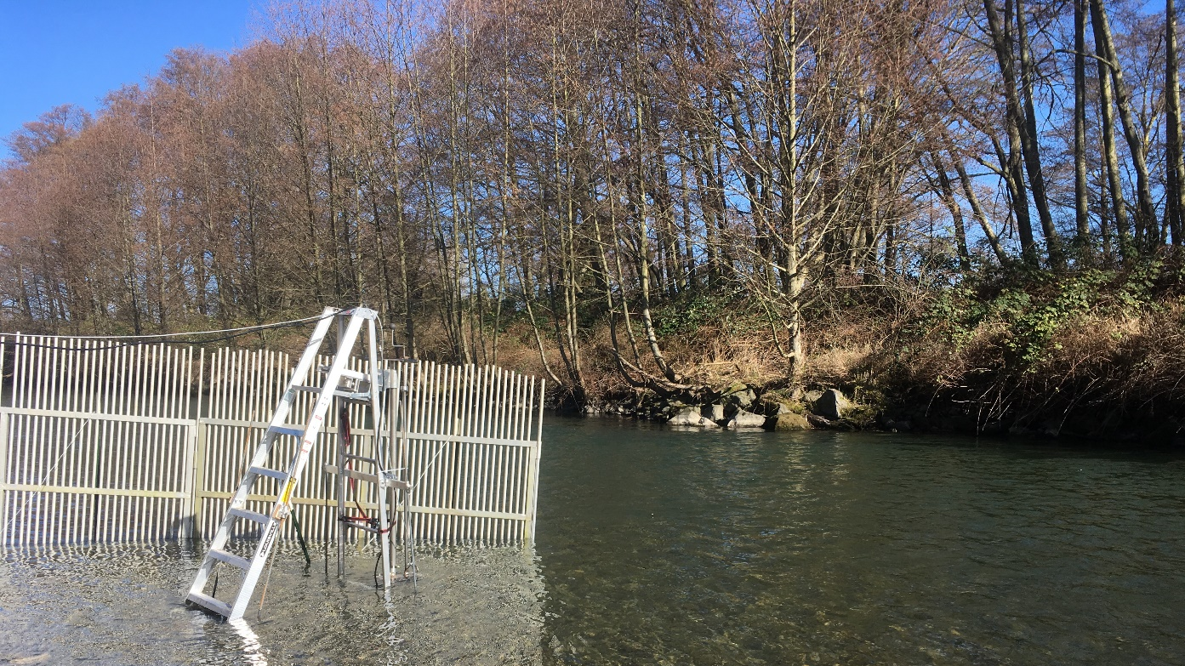
Dungeness River winter steelhead SONAR project

Slide 2
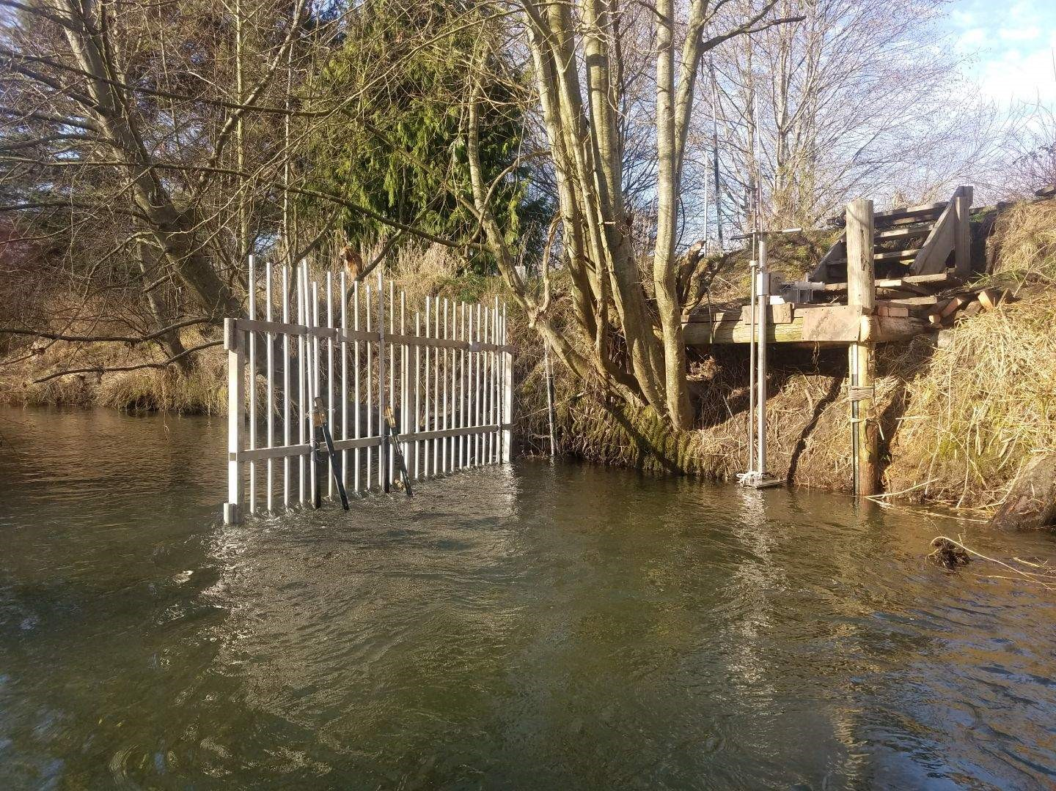
Dungeness River winter steelhead SONAR project
Alternative to redd surveys
Stationary multi-beam SONAR in lower river
Enumerate and gather run-timing information on winter steelhead
Operated annually since 2018
Notes:
Traditional redd surveys are challenging in the Dungeness River due to spring snow melt. In most years it is not possible to survey through the entirety of winter steelhead spawning season, and in some years poor survey conditions prevent an adequate number of redd surveys to estimate escapement. As an alternative method to redd counts since 2018 the Science Division has annually operated a multibeam stationary SONAR in the lower Dungeness River to enumerate and gather run-timing information on winter steelhead. Successfully operated every spring from February or March to July since 2018. We’ve had challenges with staffing and data review which have prevented us from generating escapement estimates, but we anticipate completing estimates this year for 2019-2021. This spring Regional staff led by Kathryn Sutton conducted weekly species composition netting as conditions allowed which will enable us to partition weekly fish counts into steelhead or bull trout.

Slide 4
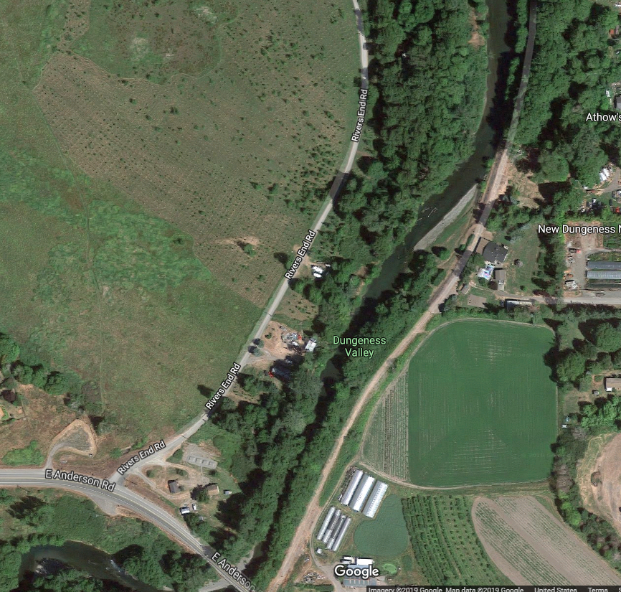

Slide 5
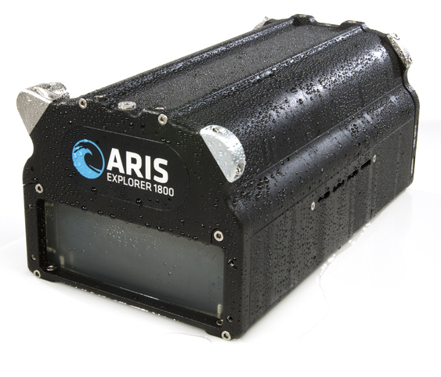
SONAR installed February 13- July 26, 2020
Notes:
2020 & 2021 location and design

Slide 6
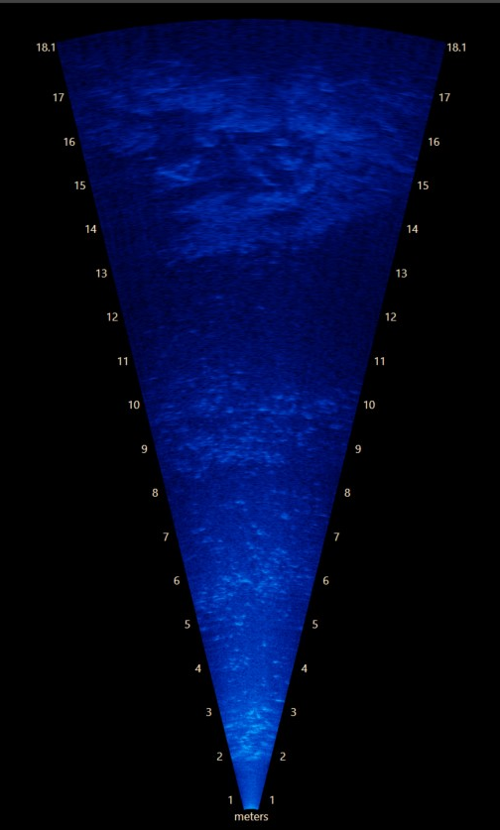
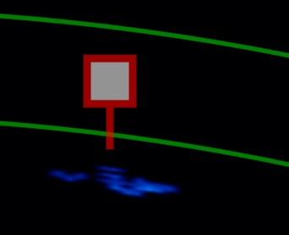
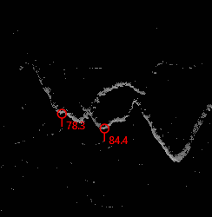
Fish counting protocols
Review first 30 minutes of each hour
Count and measure fish >45 cm
Direction of movement
Fish length
Distance from sonar
Time
Confidence in observation
Notes:
Size threshold determined by JSK angling steelhead length data

Slide 7
Data recorded and reviewed
First 30 minutes reviewed
Full hour reviewed

Slide 8
Net upstream migration
 | SONAR Operation |  | Steelhead Period
Year | First day | Last day | First day | Last day
2019 | Mar. 5 | Oct. 10 | Mar. 5 | Jun. 7
2020 | Feb. 14 | Jul. 25 | Feb. 14 | Jun. 7
2021 | Feb. 2 | Jun. 22 | Feb. 2 | Jun. 7
Notes:
February 1- June 10th
Steelhead passage for EE = through June 7th

Slide 9
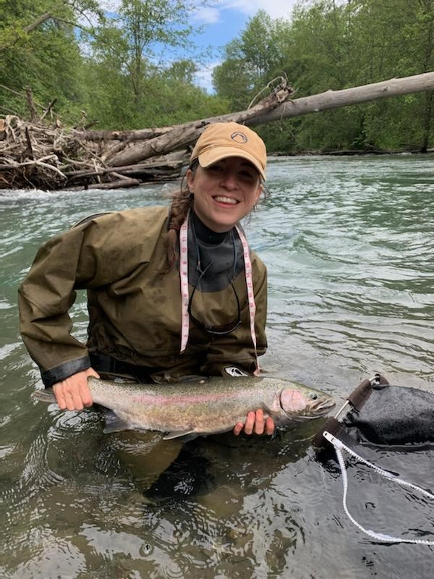
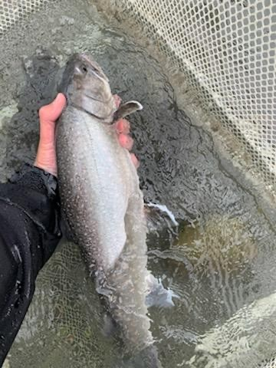
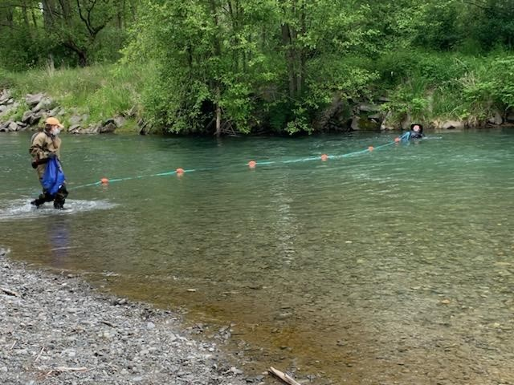
Species composition netting
 | Counts |  | Proportions
Date | Bull Trout | Steelhead | Bull Trout | Steelhead
2/3/2021 | 3 | 0 | 100 | 0
2/17/2021 | 1 | 2 | 33.3 | 66.7
2/25/2021 | 0 | 2 | 0 | 100
3/1/2021 | 0 | 0 | - | -
3/17/2021 | 0 | 1 | 0 | 100
3/25/2021 | 0 | 2 | 0 | 100
4/1/2021 | 0 | 2 | 0 | 100
4/8/2021 | 0 | 6 | 0 | 100
4/14/2021 | 0 | 4 | 0 | 100
4/28/2021 | 2 | 1 | 66.7 | 33.3
5/6/2021 | 0 | 0 | - | -
5/12/2021 | 0 | 0 | - | -
6/8/2021 | 7 | 0 | 100 | 0
6/17/2021 | 5 | 0 | 100 | 0
TOTAL | 18 | 20
Notes:
67% of fish lengths in February are steelhead size (larger than bull trout, >67 cm length)
3 HORs caught early April, 1 on 4/1 and 2 on 4/8

Slide 10
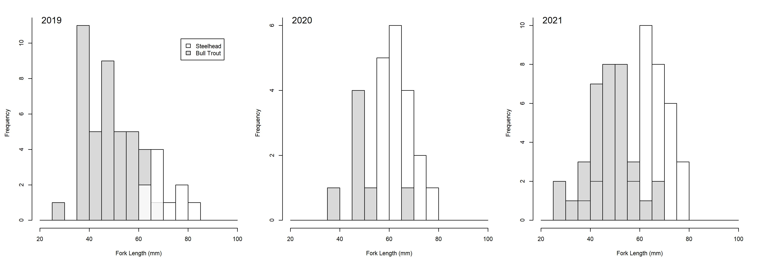
Fish size distributions
Notes:
From JSK Hook & Line, and DFW/JSK species comp netting 2019 & 2021
Overlap between bull trout and steelhead up to 67 cm FL

Slide 11
Winter steelhead abundance estimate
Steelhead passage dates
Net upstream migration (# of fish upstream - # of fish downstream)
Include kelts
Expand 30-minute counts
Account for outages
Exclude bull trout
Notes:
Size threshold determined by JSK angling steelhead length data

Slide 12
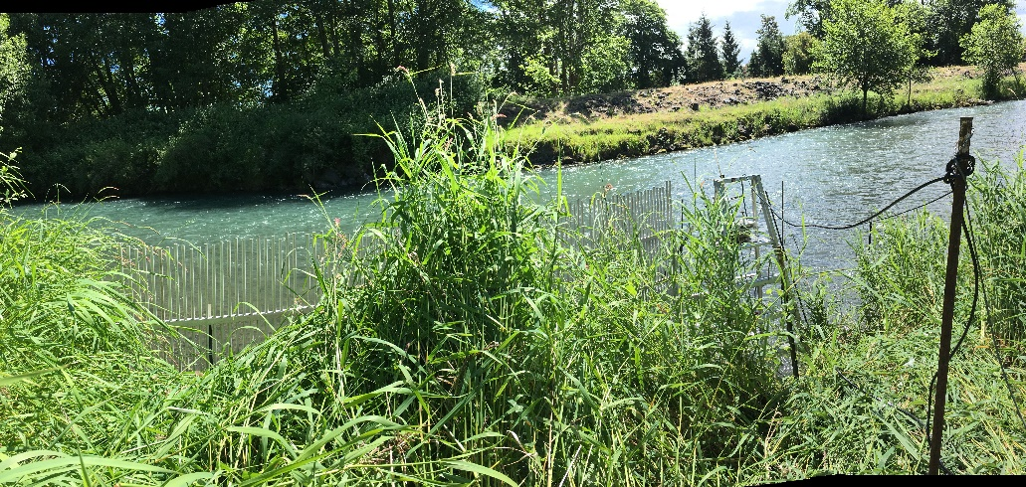
Thank you
Kathryn Sutton
Andrew Simmons
Brent Trim
Calvin Stokes
Pete Topping
Joe Anderson
Jenni Whitney
Chris Burns (JSK)
Jarrett Burns (JSK)
Casey Allen (JSK)
Keith Denton (K. Denton & Associates)
Roger Tabor (USFWS)
Roger Peters (USFWS)
Greg Byford(USFWS)
Dave Shreffler (Shreffler Environmental)

